Slide 1
Handwritten Letters and Numbers
classification system
Done by : Anas Nofal

Slide 2

1
2
DESCRIBING THE PROBLEM
AND THE DATA
DATA PREPARATION
3
4
Model Selection
Model Evaluation

Slide 3
01
DESCRIBING THE PROBLEM
AND THE DATA

Slide 4
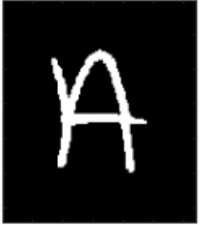
DESCRIBING THE PROBLEM
To build a CNN model that take a sample image of a handwritten letter and classify it.
CNN Model
10

Slide 5
the data set
the data set is a 28×28 pixel grayscale images of handwritten single character
There are 785 columns in the data set, one of which is the label column and the rest are pixels.
the pixel values for each image in the dataset are unsigned integers in the range between black and white, or 0 and 255.

Slide 6
balanced data
The data is splitted into training and testing data , and both are balanced .
The training data set has 112799 images, with 2400 for each character except 45, which is the letter ‘r'.
the testing data set has 18799 images with 400 for each character except 41, which is the letter ‘g'.

Slide 7
02
DATA PREPARATION

Slide 8
loading the data
I began by loading the training data.
then Divided into x and y(label)
and converting the X into numpy array

Slide 9
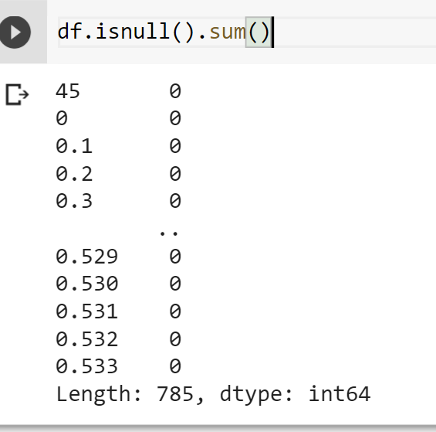
null values
determining if there are any null values

Slide 10
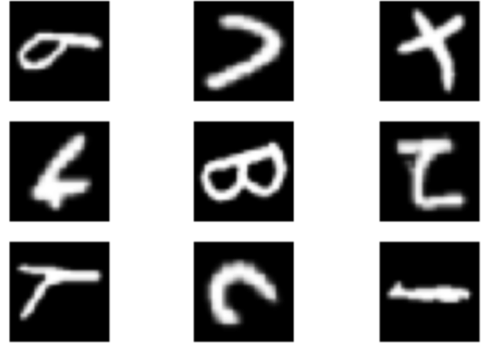
taking a look at the data
the data is flipped and need rotation

Slide 11
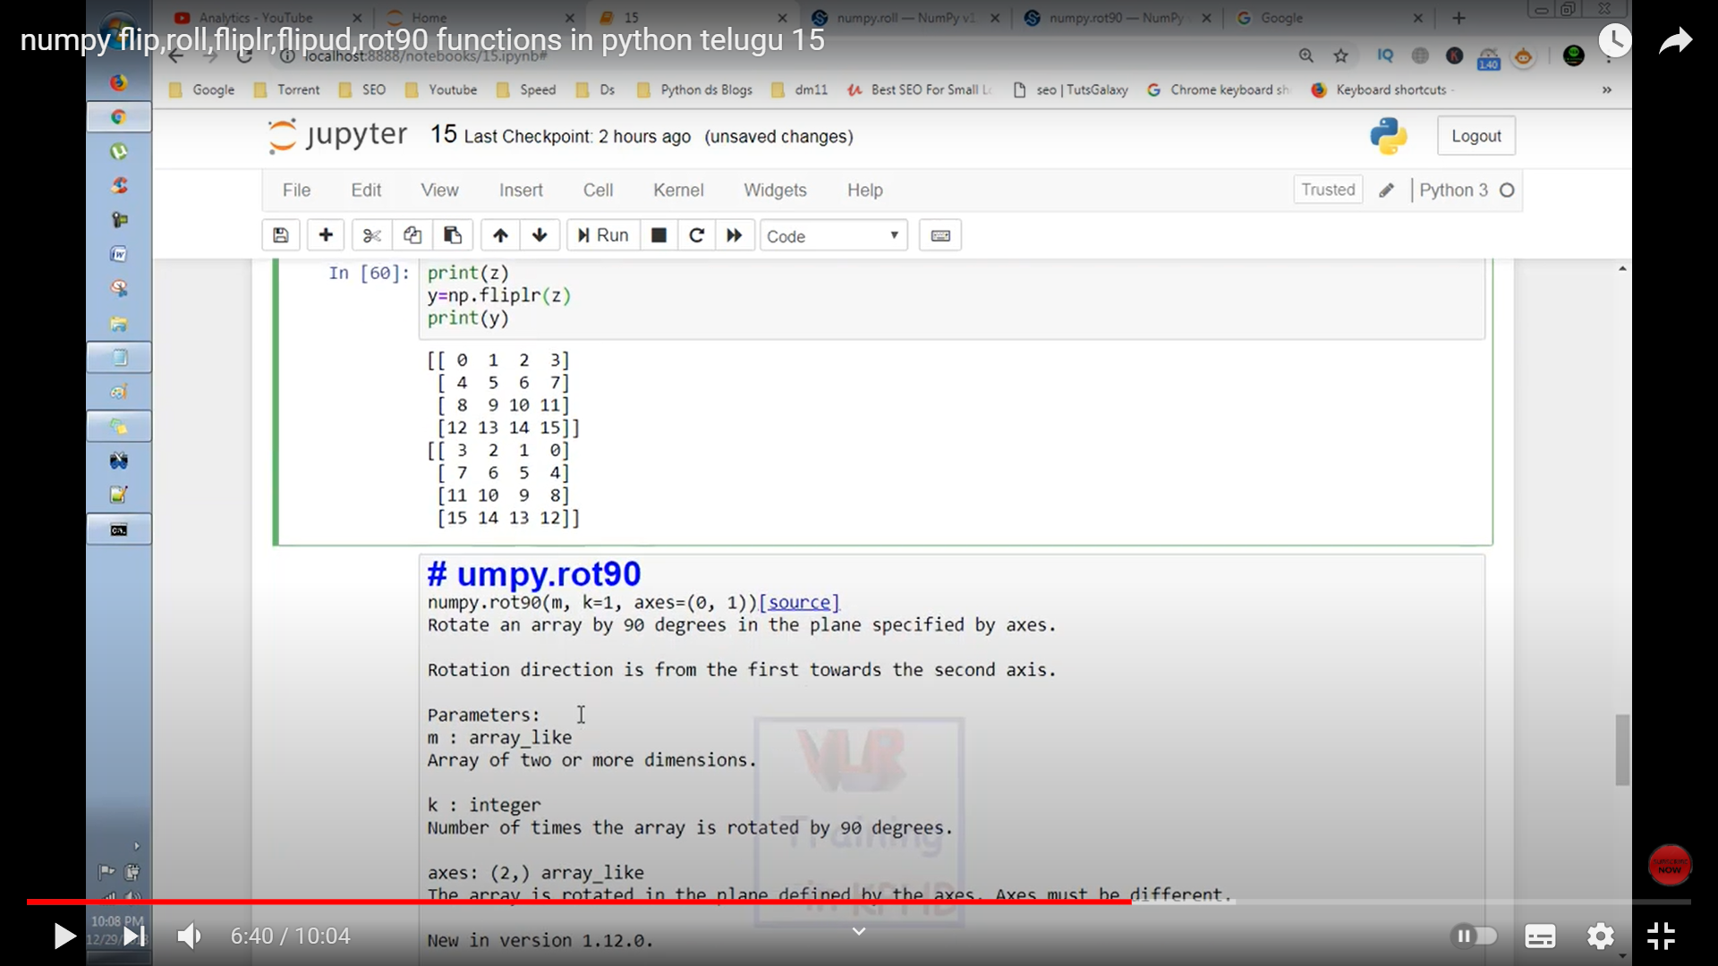
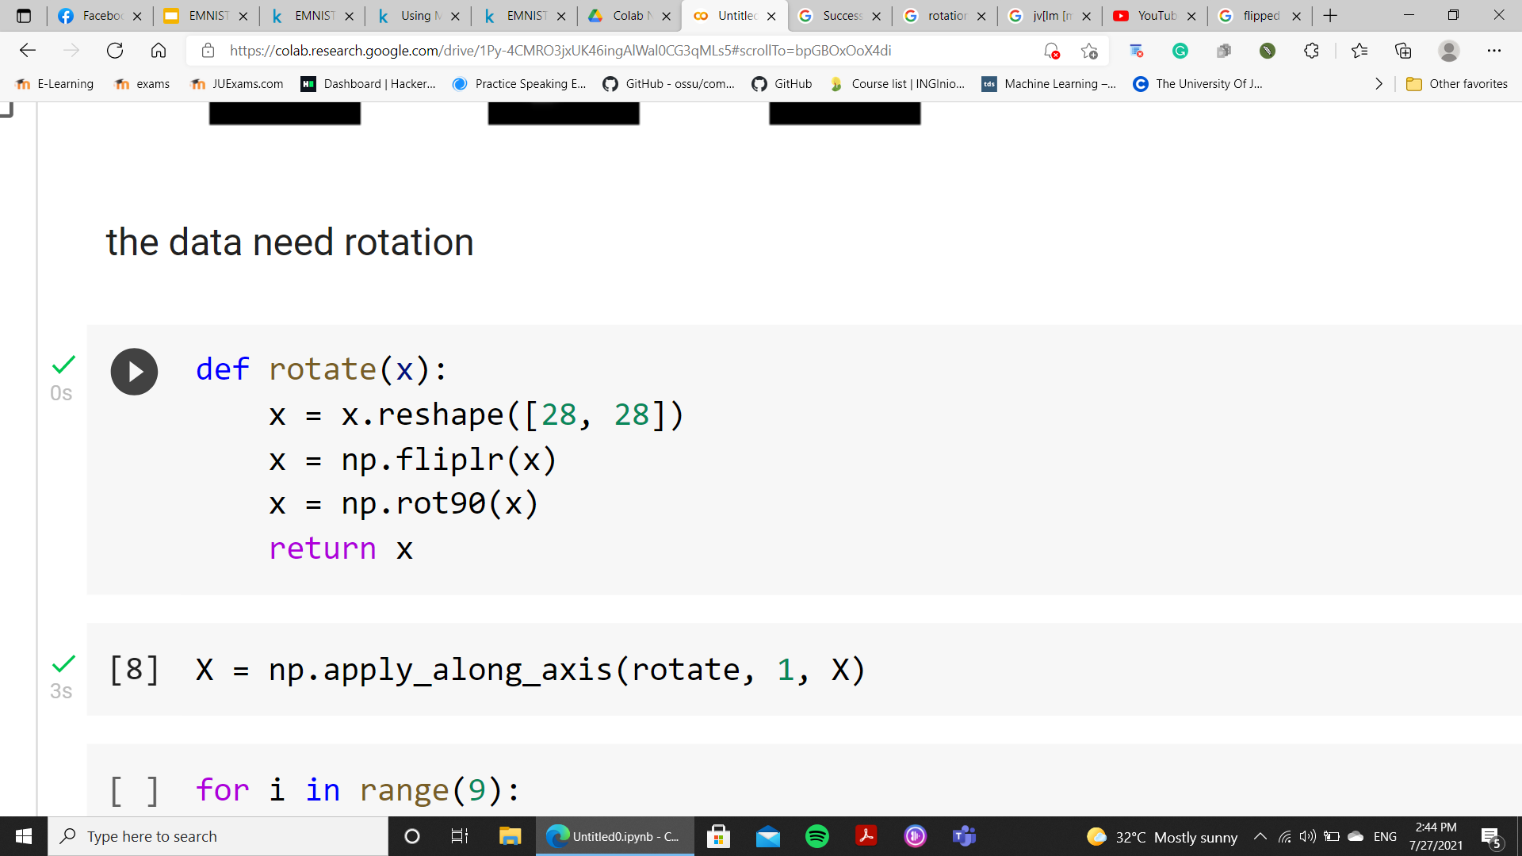
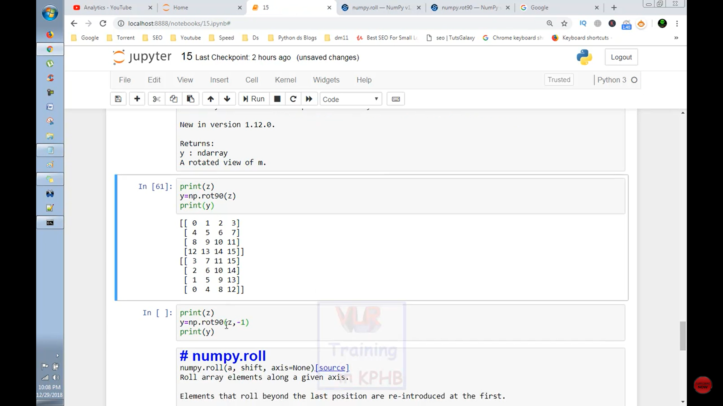
data rotation

Slide 12
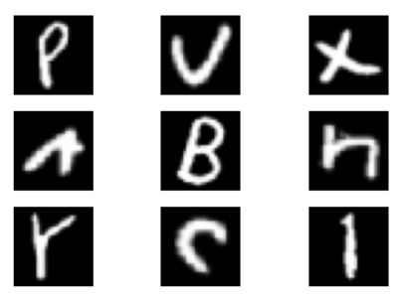
data rotated

Slide 13
Pixel Normalization
Pixel Normalization: scale pixel values to the range 0-1 which is preferred for neural network models.

Slide 14
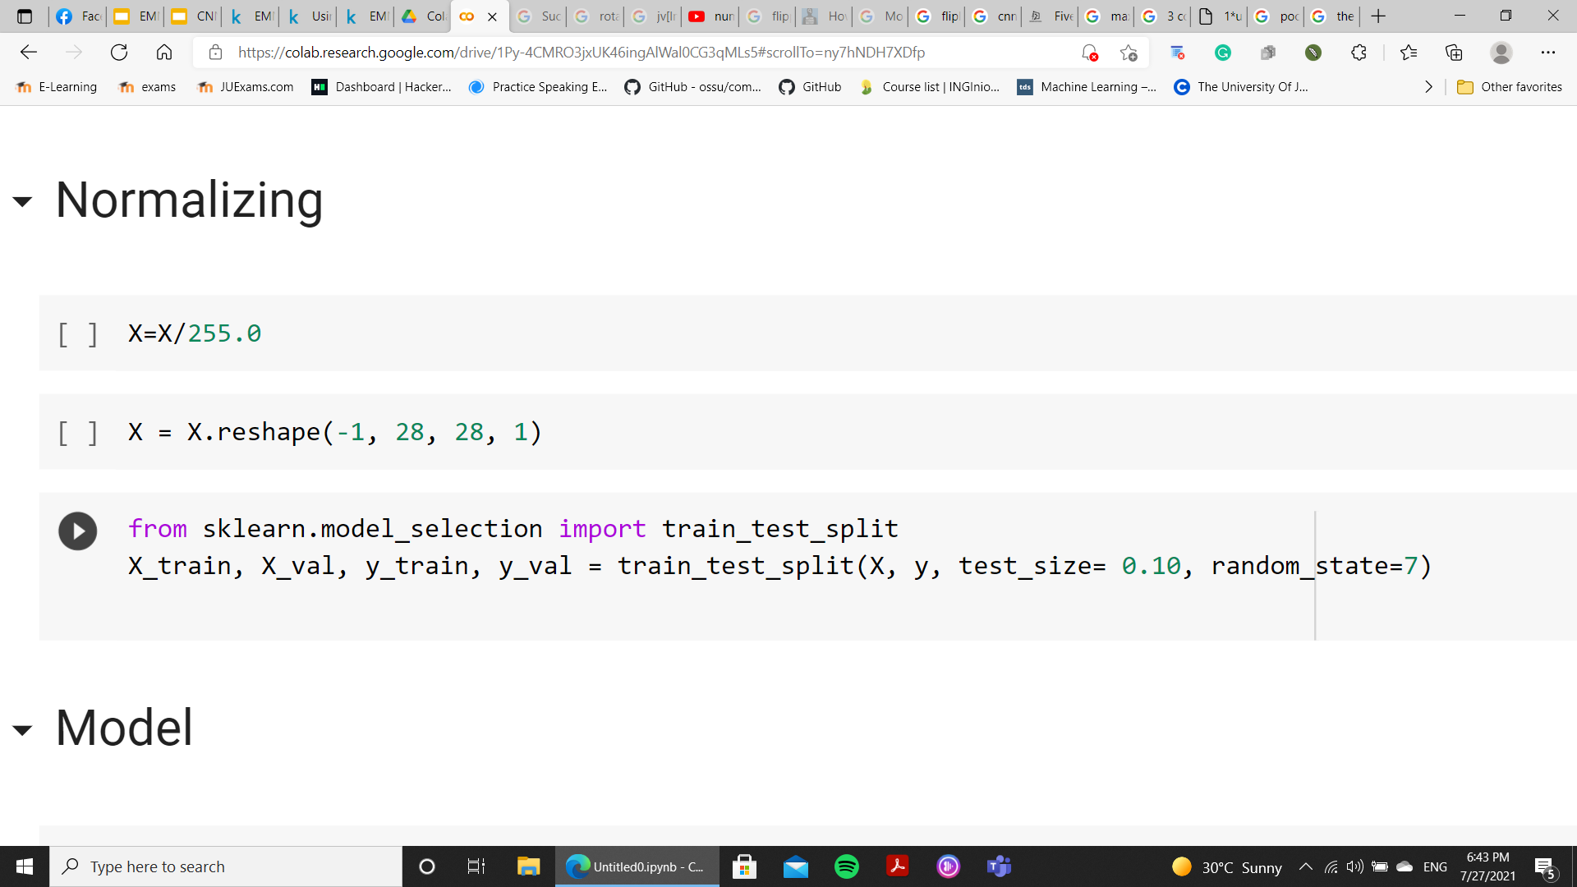
validation data
the is splitted into 0.9 training and 0.1 validation

Slide 15
03
Model Selection

Slide 16
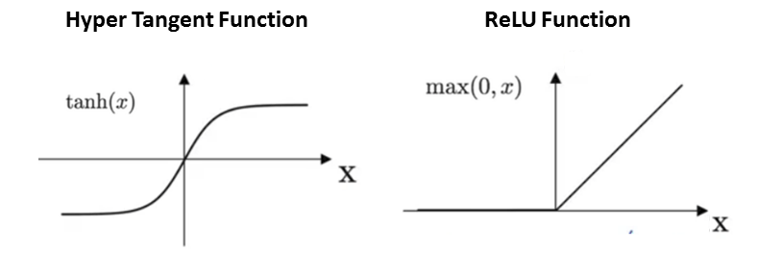
THE ACTIVATION FUNCTION
Activation functions are what allows neurons to turn ON or OFF.
Used to map the weighted sum between 0 and 1, or -1 to -1.

Slide 17

pooling method
The pooling layer replaces the features maps by deriving a summary statistics of the nearby pixels.
Pooling reduces the image size, which reduces the required amount of computations.
Different pooling types can be used like Min, Avg, and Max pooling.

Slide 18
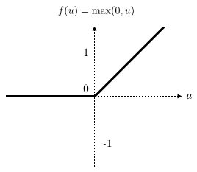
FIRST MODEL
first model with relu and max pooling
model = keras.models.Sequential()
model.add(keras.layers.Conv2D(32,3,padding ='same',activation='relu',input_shape=(28,28,1)))
model.add(keras.layers.MaxPool2D(pool_size=(2,2)))
model.add(keras.layers.Conv2D(64,3,padding ='same',activation='relu'))
model.add(keras.layers.MaxPool2D(pool_size=(2,2)))
model.add(keras.layers.Conv2D(128,3,padding ='same',activation='relu'))
model.add(keras.layers.MaxPool2D(pool_size=(2,2)))
#until here the output is 2D,so to work with dense we need to flatten
model.add(keras.layers.Flatten())
model.add(keras.layers.Dense(256, activation = "relu"))
model.add(keras.layers.Dropout(0.25))
model.add(keras.layers.Dense(128, activation = "relu"))
model.add(keras.layers.Dropout(0.25))
model.add(keras.layers.Dense(47, activation = "softmax"))

Slide 19
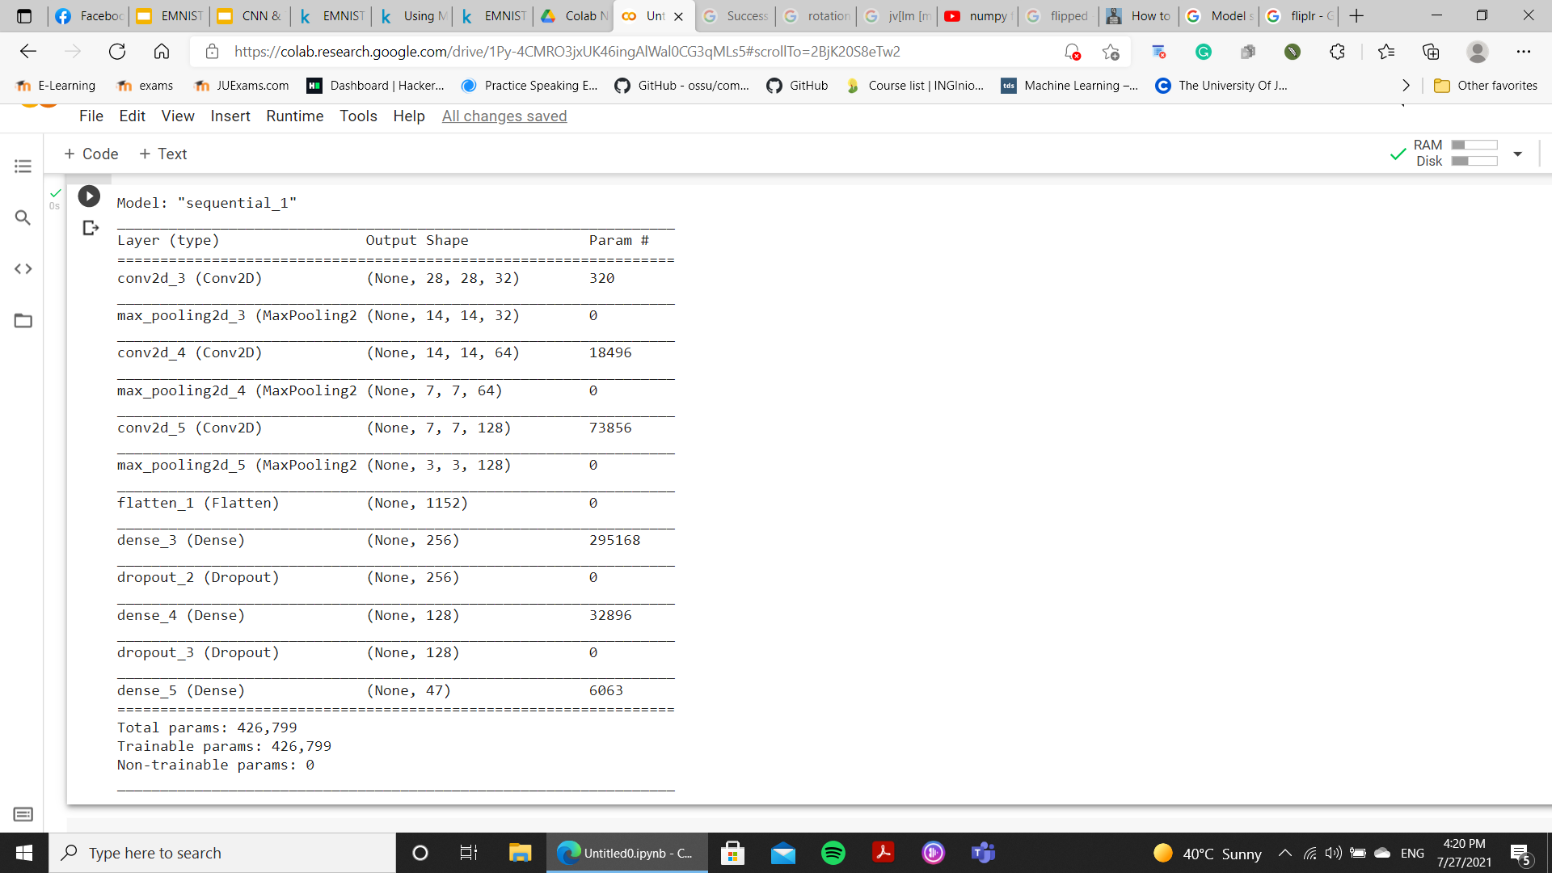
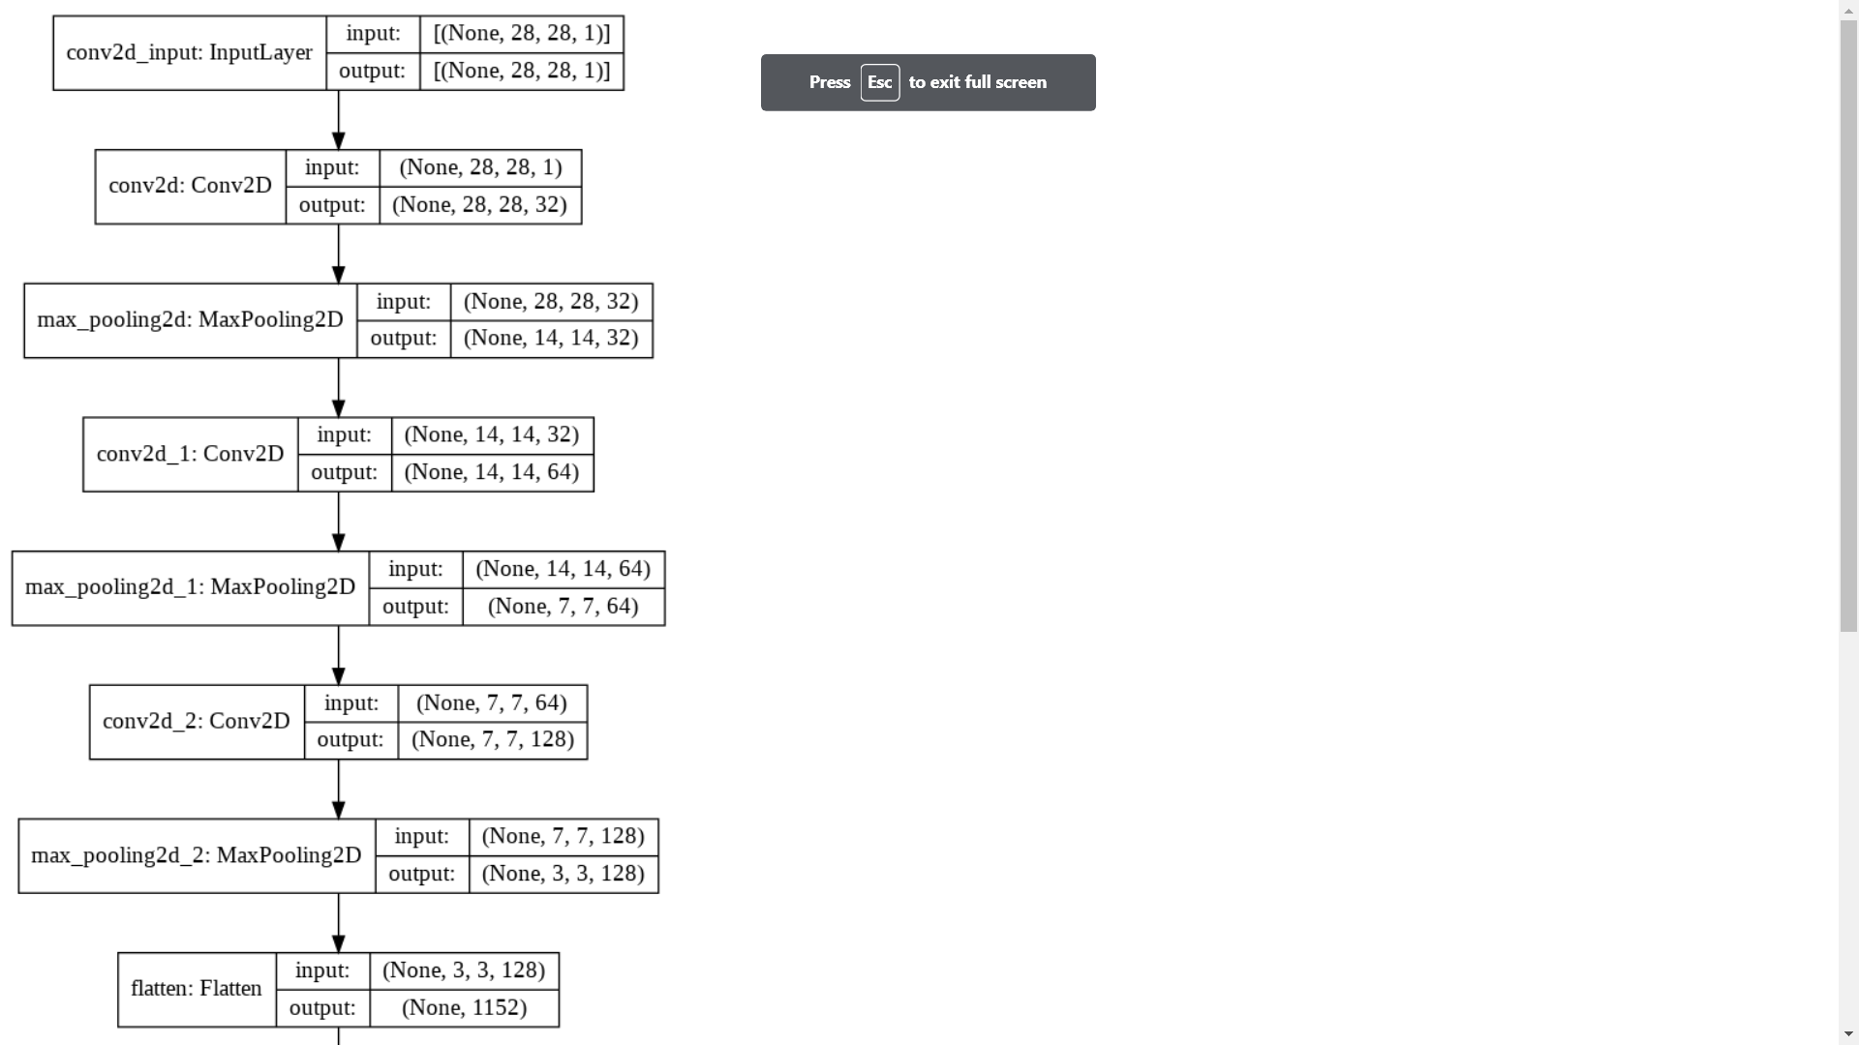
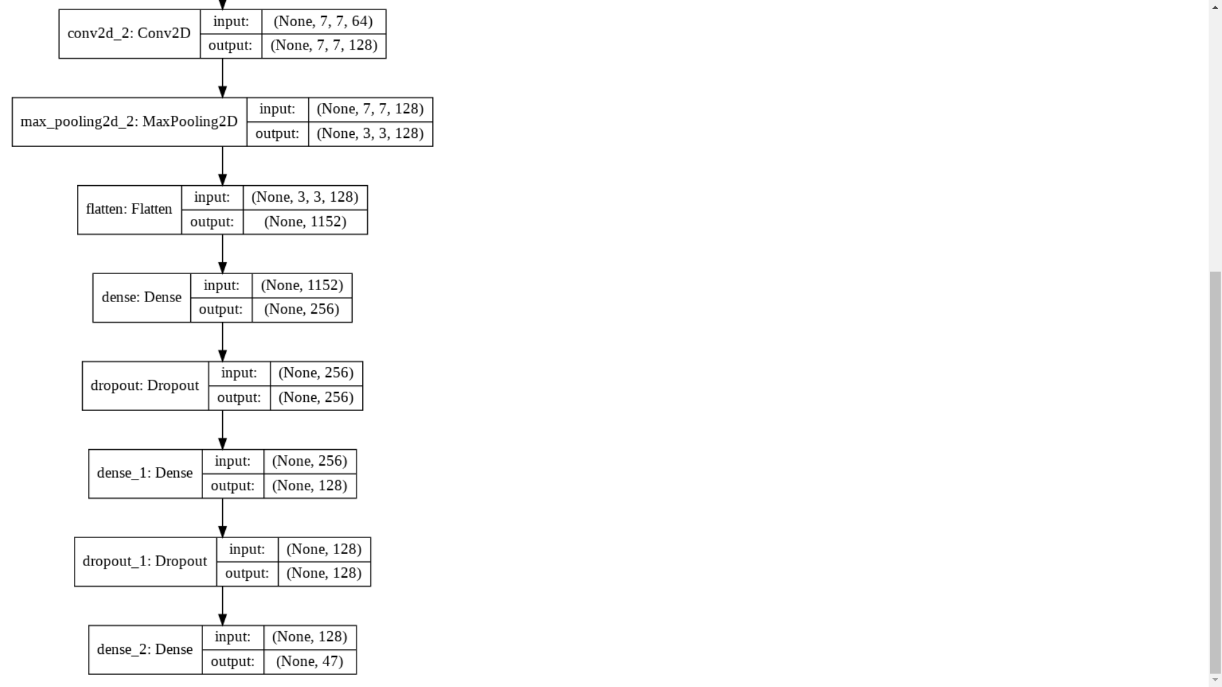
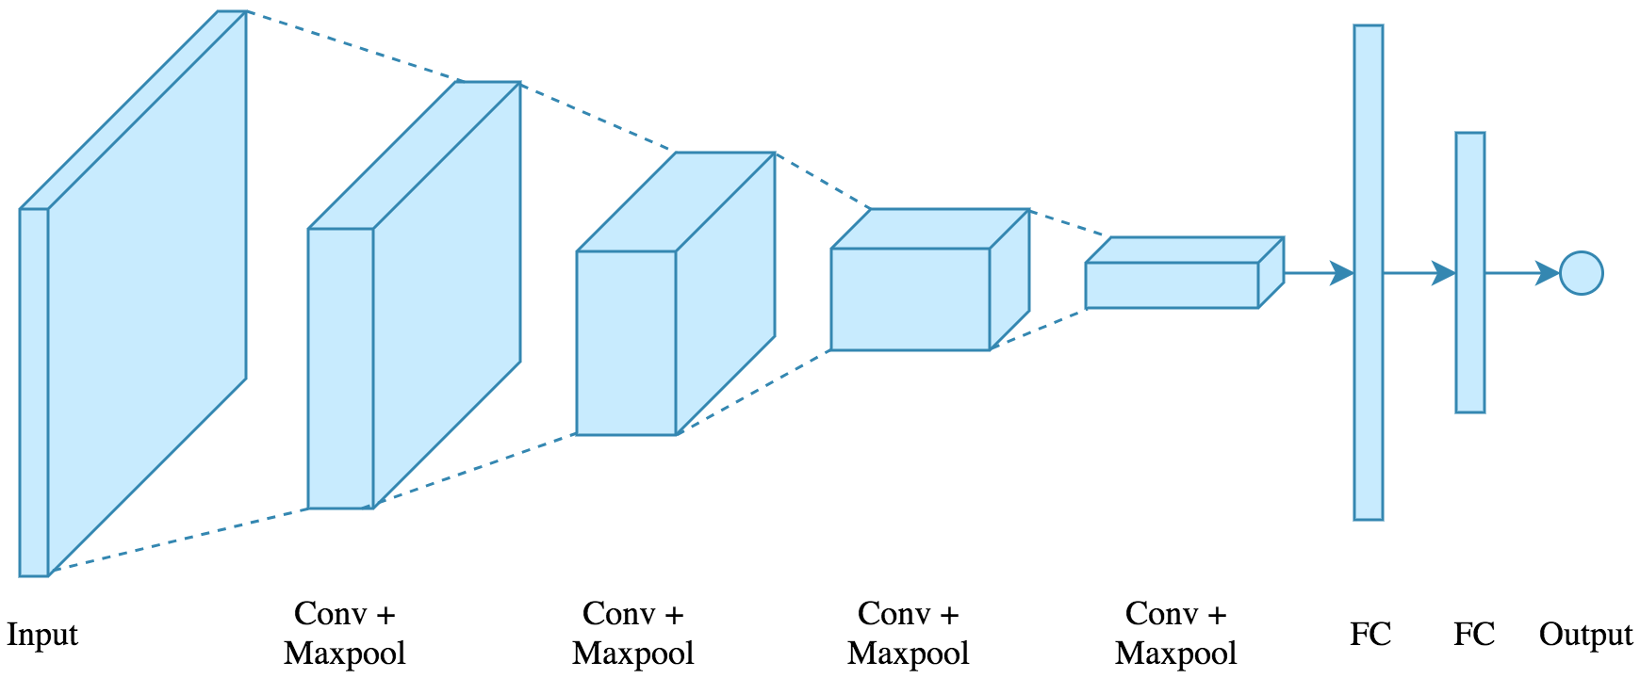
cnn model architecture

Slide 20
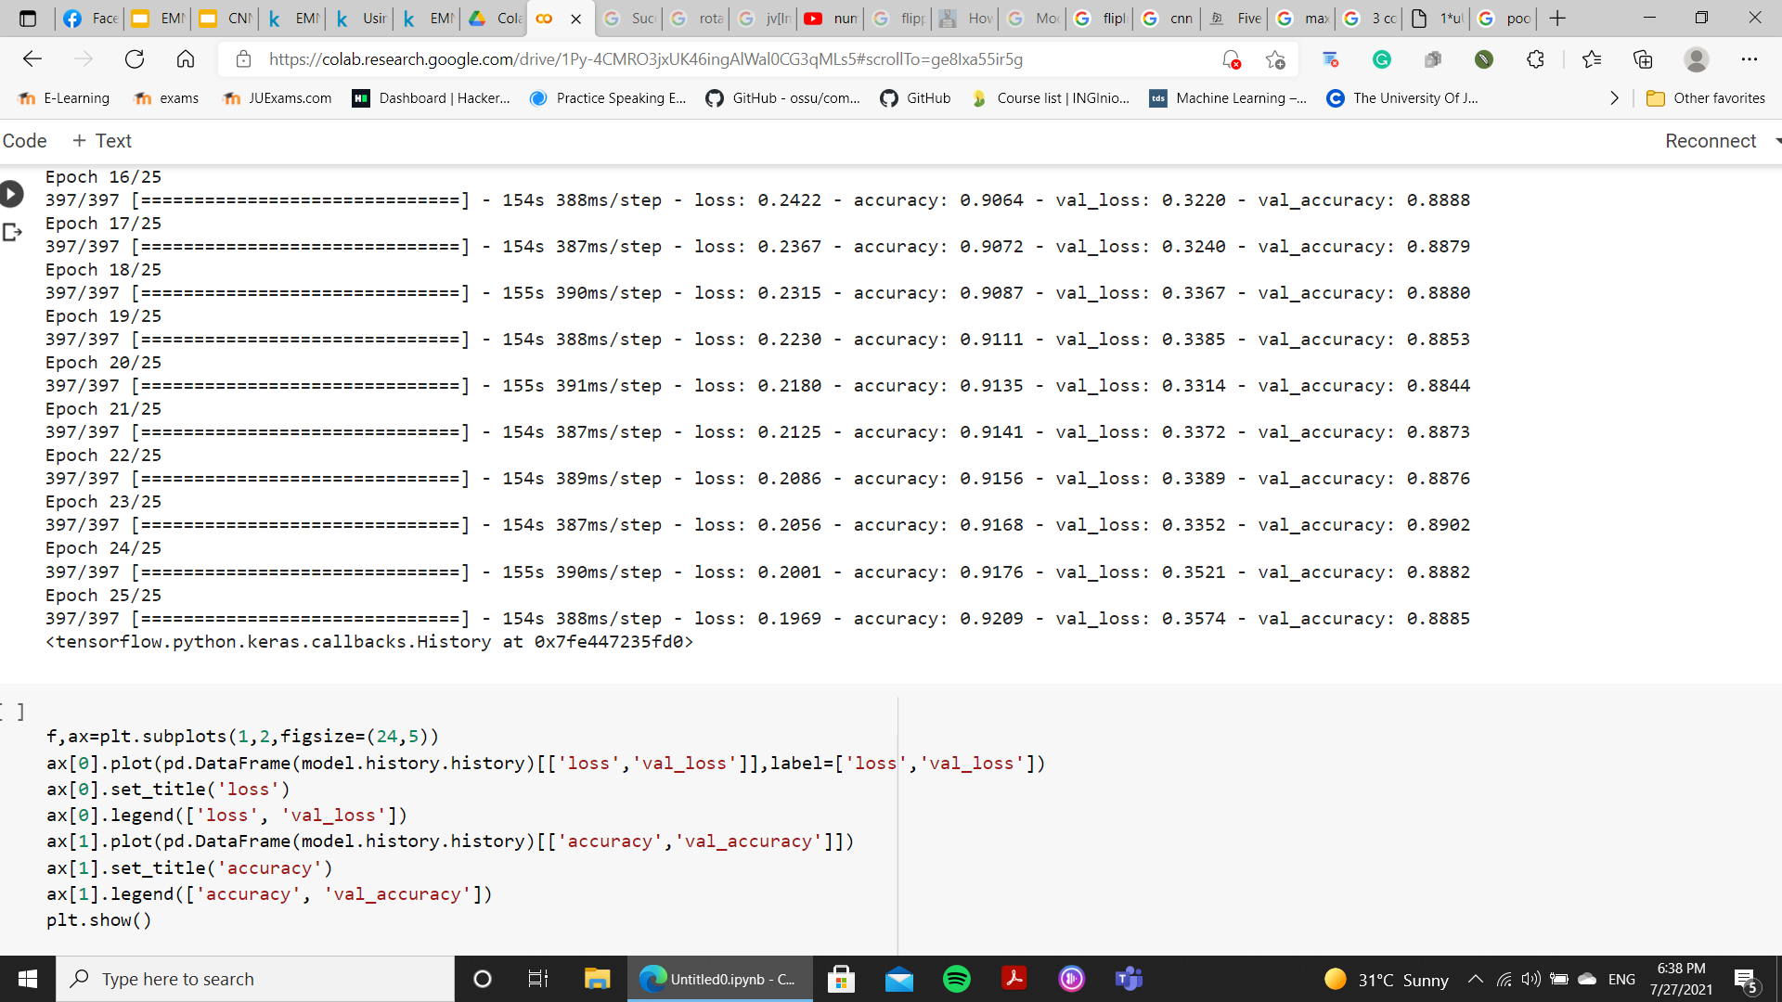
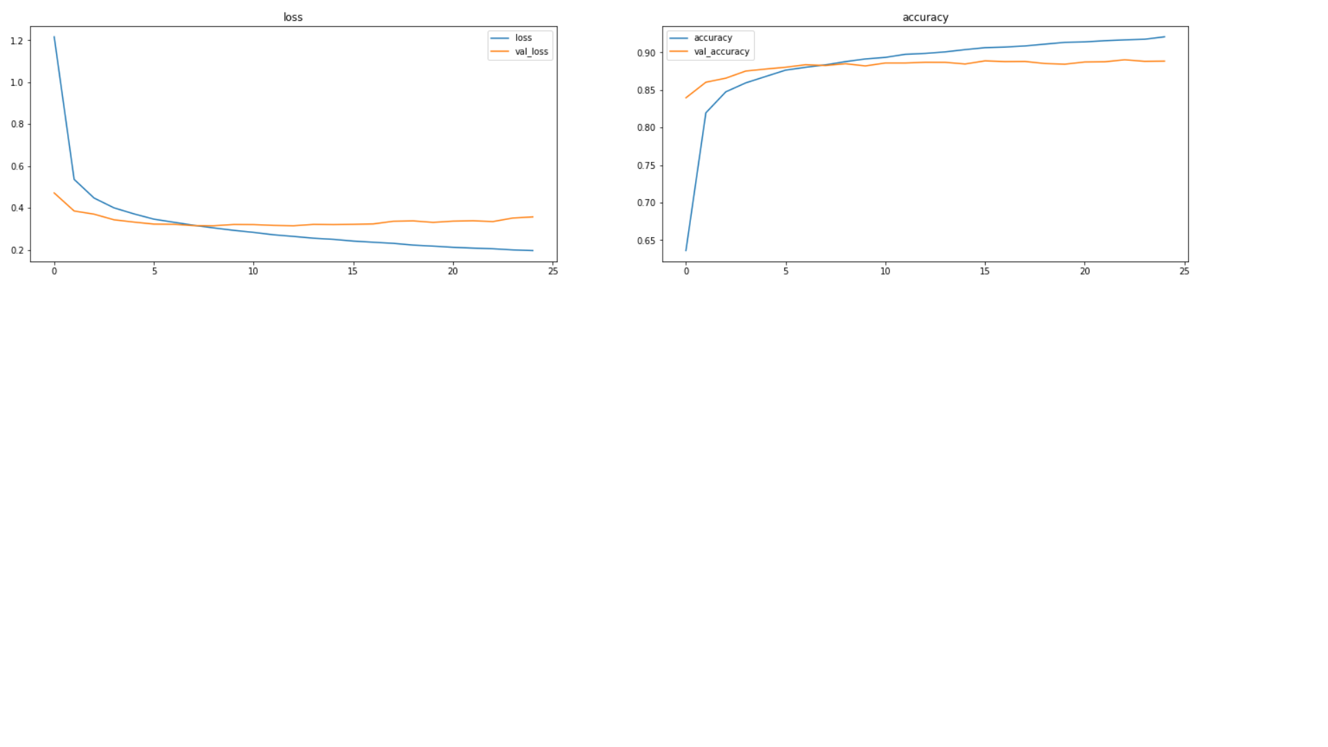
model loss and accuracy
this model get 92 accuracy on the training and 0.88 on the validation
this model get 0.1969 loss on the training and 0.3574 on the validation

Slide 21
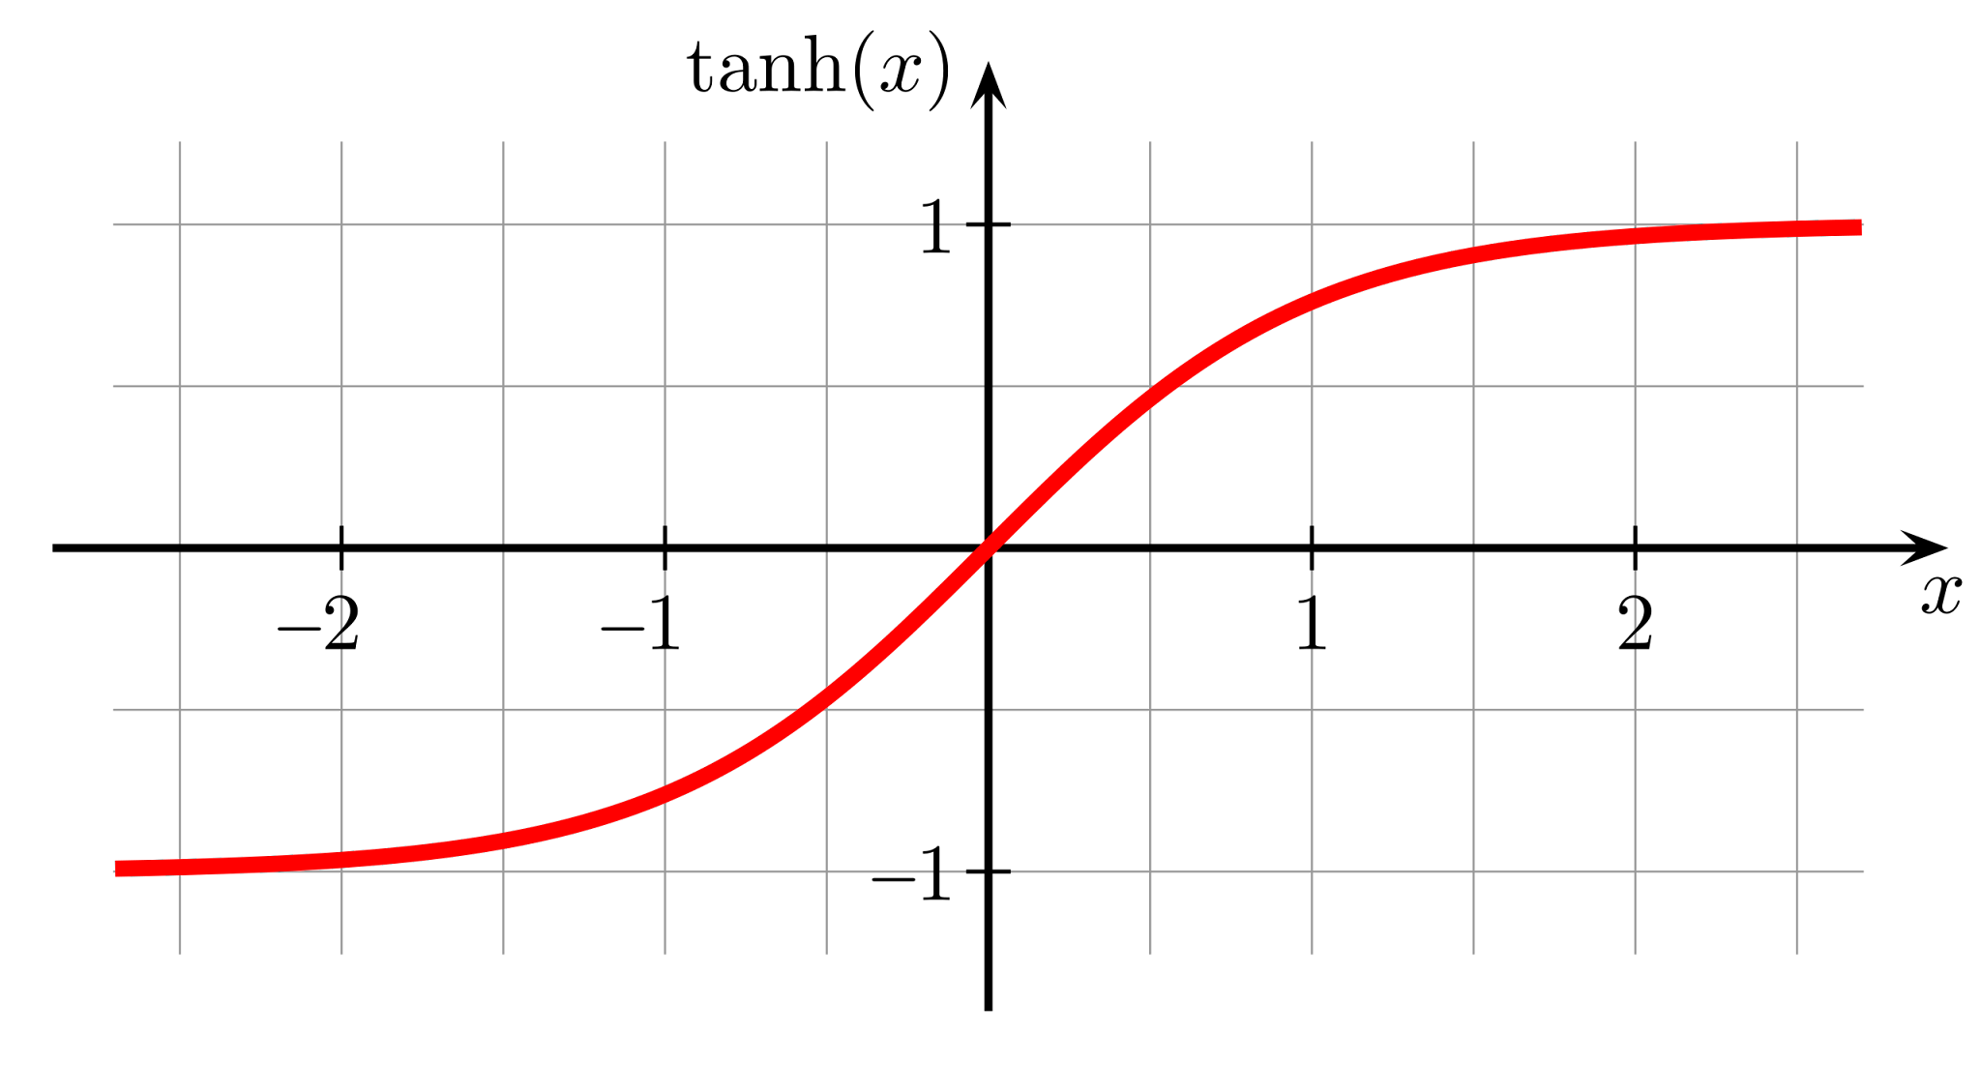
SECOND MODEL
Second model with tanh and max pooling
model2 = keras.models.Sequential()
model2.add(keras.layers.Conv2D(16,3,padding ='same',activation='tanh',input_shape=(28,28,1)))
model2.add(keras.layers.MaxPool2D(pool_size=(2,2)))
model2.add(keras.layers.Conv2D(32,3,padding ='same',activation='tanh'))
model2.add(keras.layers.MaxPool2D(pool_size=(2,2)))
model2.add(keras.layers.Conv2D(64,3,padding ='same',activation='tanh'))
model2.add(keras.layers.MaxPool2D(pool_size=(2,2)))
#until here the output is 2D,so to work with dense we need to flatten
model2.add(keras.layers.Flatten())
model2.add(keras.layers.Dense(256, activation = "tanh"))
model2.add(keras.layers.Dense(128, activation = "tanh"))
model2.add(keras.layers.Dense(47, activation = "softmax"))

Slide 22
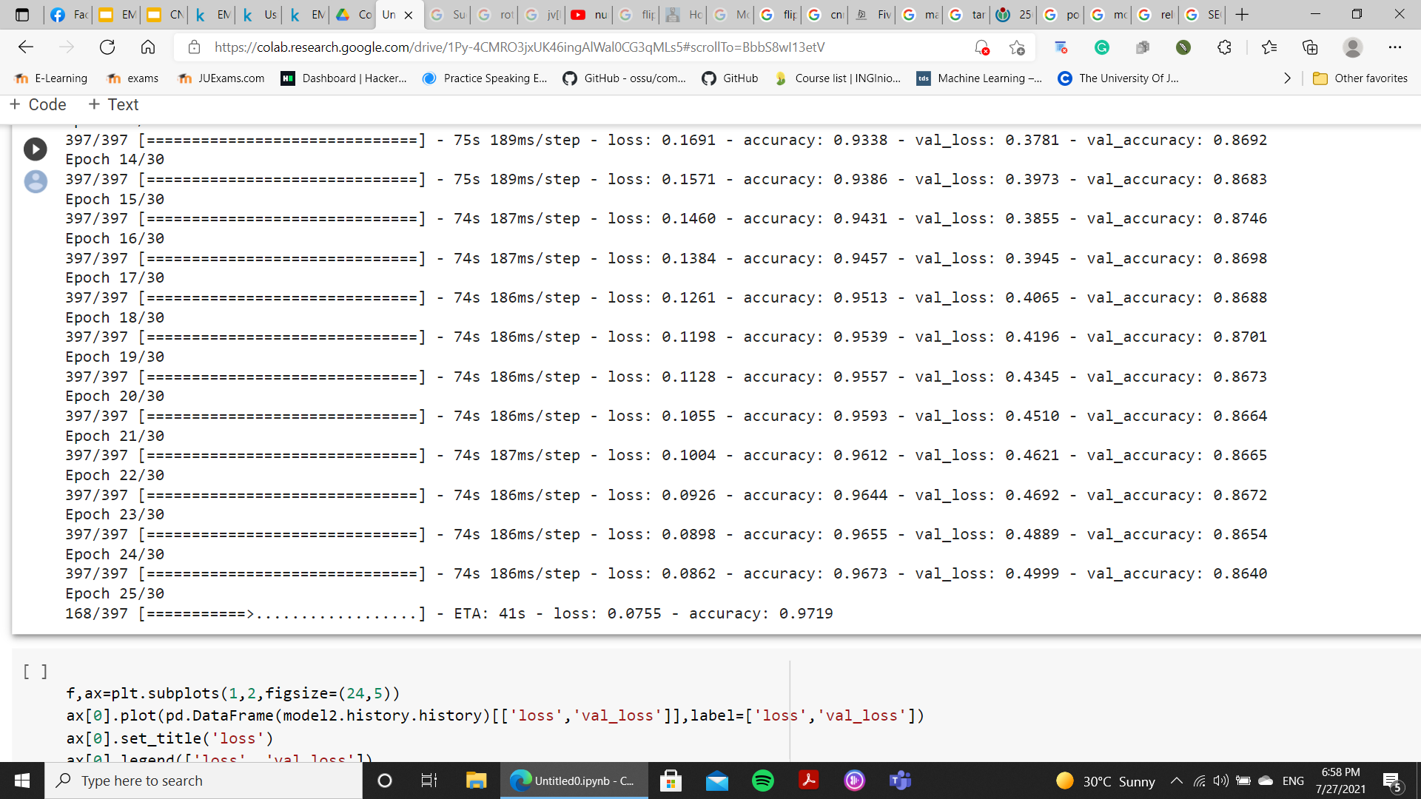
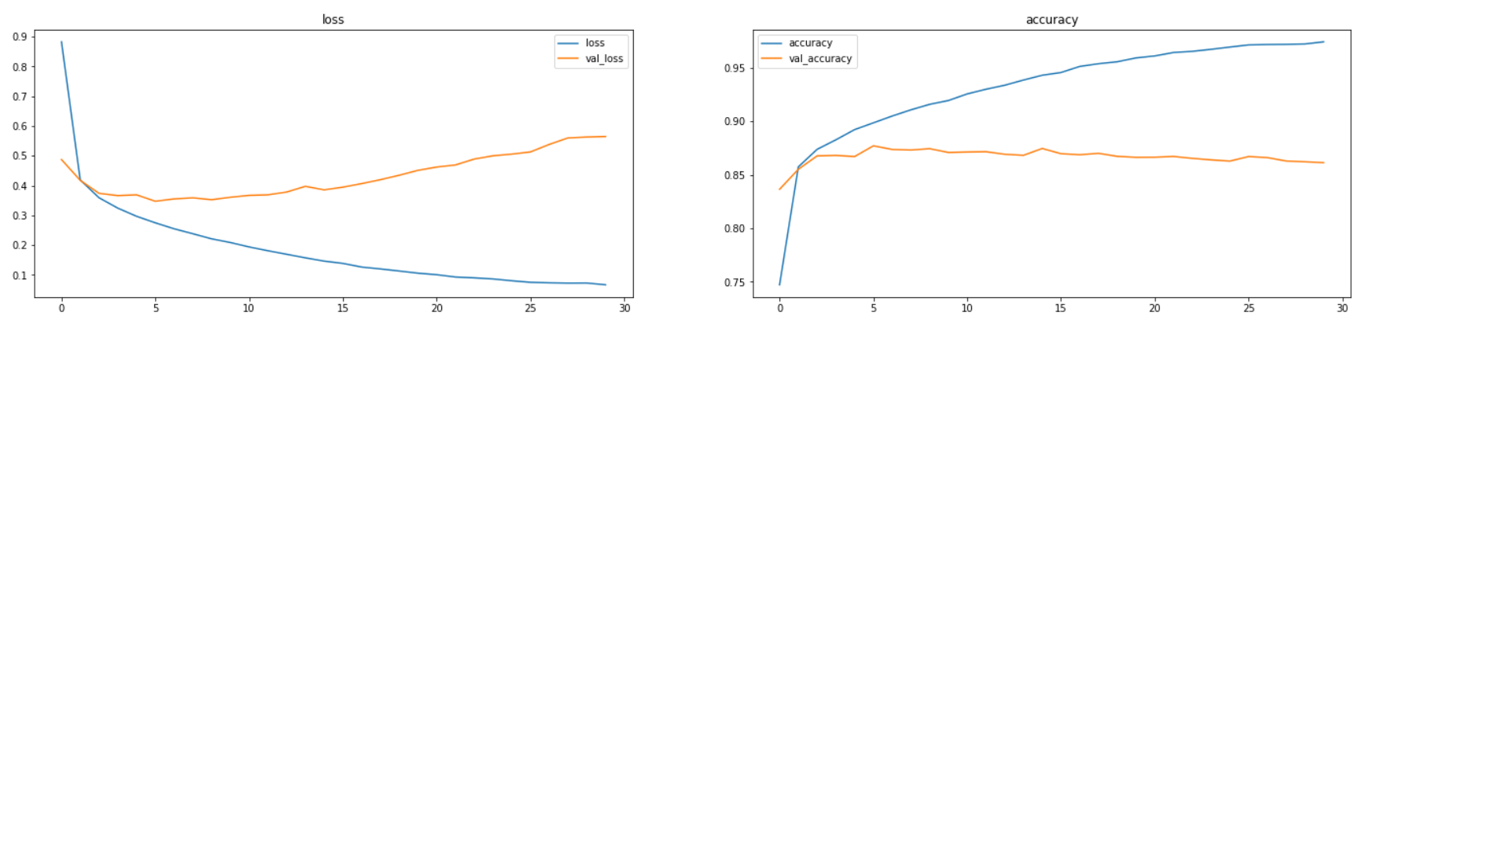
model loss and accuracy
this model get 96.7 accuracy on the training and 0.864 on the validation
this model get 0.0862 loss on the training and 0.4999 on the validation
as we can see this model overly overfitted the data

Slide 23
THIRD MODEL
Third model with average pooling
model3 = keras.models.Sequential()
model3.add(keras.layers.Conv2D(16,3,padding ='same',activation='relu',input_shape=(28,28,1)))
model3.add(keras.layers.AveragePooling2D(pool_size=(2,2)))
model3.add(keras.layers.Conv2D(32,3,padding ='same',activation='relu'))
model3.add(keras.layers.AveragePooling2D(pool_size=(2,2)))
model3.add(keras.layers.Conv2D(64,3,padding ='same',activation='relu'))
model3.add(keras.layers.AveragePooling2D(pool_size=(2,2)))
#until here the output is 2D,so to work with dense we need to flatten
model3.add(keras.layers.Flatten())
model3.add(keras.layers.Dense(256, activation = "tanh"))
model3.add(keras.layers.Dense(128, activation = "tanh"))
model3.add(keras.layers.Dense(47, activation = "softmax"))

Slide 24
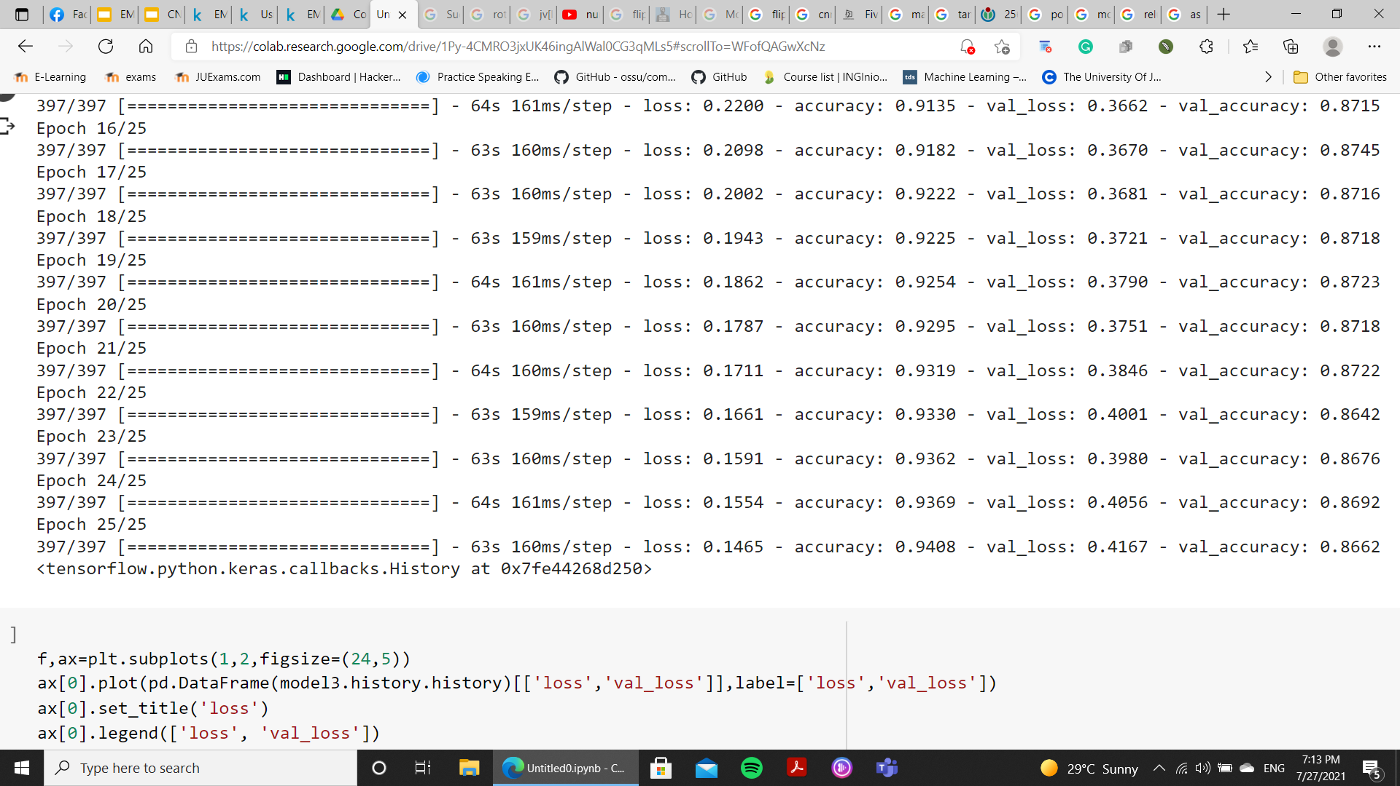
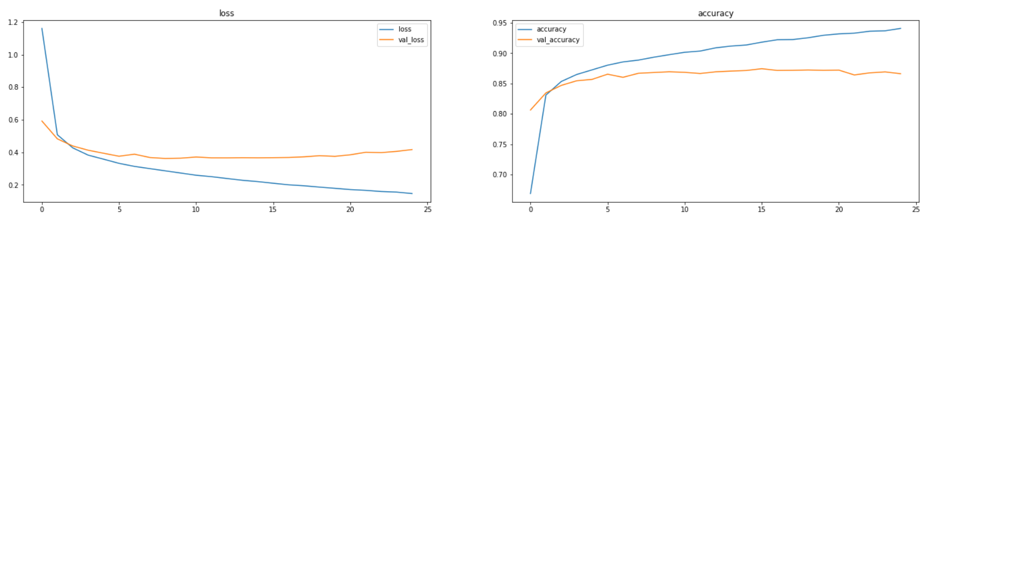
model loss and accuracy
this model get 94 accuracy on the training and 0.87 on the validation
this model get 0.146 loss on the training and 0.4167 on the validation
Average pooling method smooths out the image and hence the sharp features may not be identified when this pooling method is used. Max pooling selects the brighter pixels from the image. It is useful when the background of the image is dark and we are interested in only the lighter pixels of the image. which is preferable in our case

Slide 25
loss function and optimizer
I used the sparse_categorical_crossentropy as the loss function
25 epochs and 265 batch size
adam optimizer on all models
model.compile(loss="sparse_categorical_crossentropy",
optimizer="adam",
metrics=["accuracy"])

Slide 26
zero padding
Zero padding
No padding

Slide 27
Final model
the first model has the best loss and accuracy on the validation data
an it has the less overfitting range
As a result, it was chosen as the final model

Slide 28
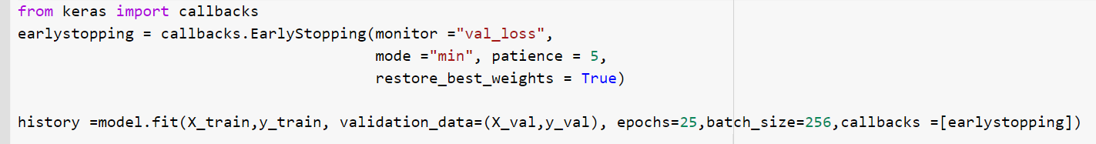
minimizing overfitting
To mitigate overfitting and to increase the generalization capacity of the neural network, the model should be trained for an optimal number of epochs. A part of training data is dedicated for validation of the model, to check the performance of the model after each epoch of training. Loss and accuracy on the training set as well as on validation set are monitored to look over the epoch number after which the model starts overfitting.

Slide 29
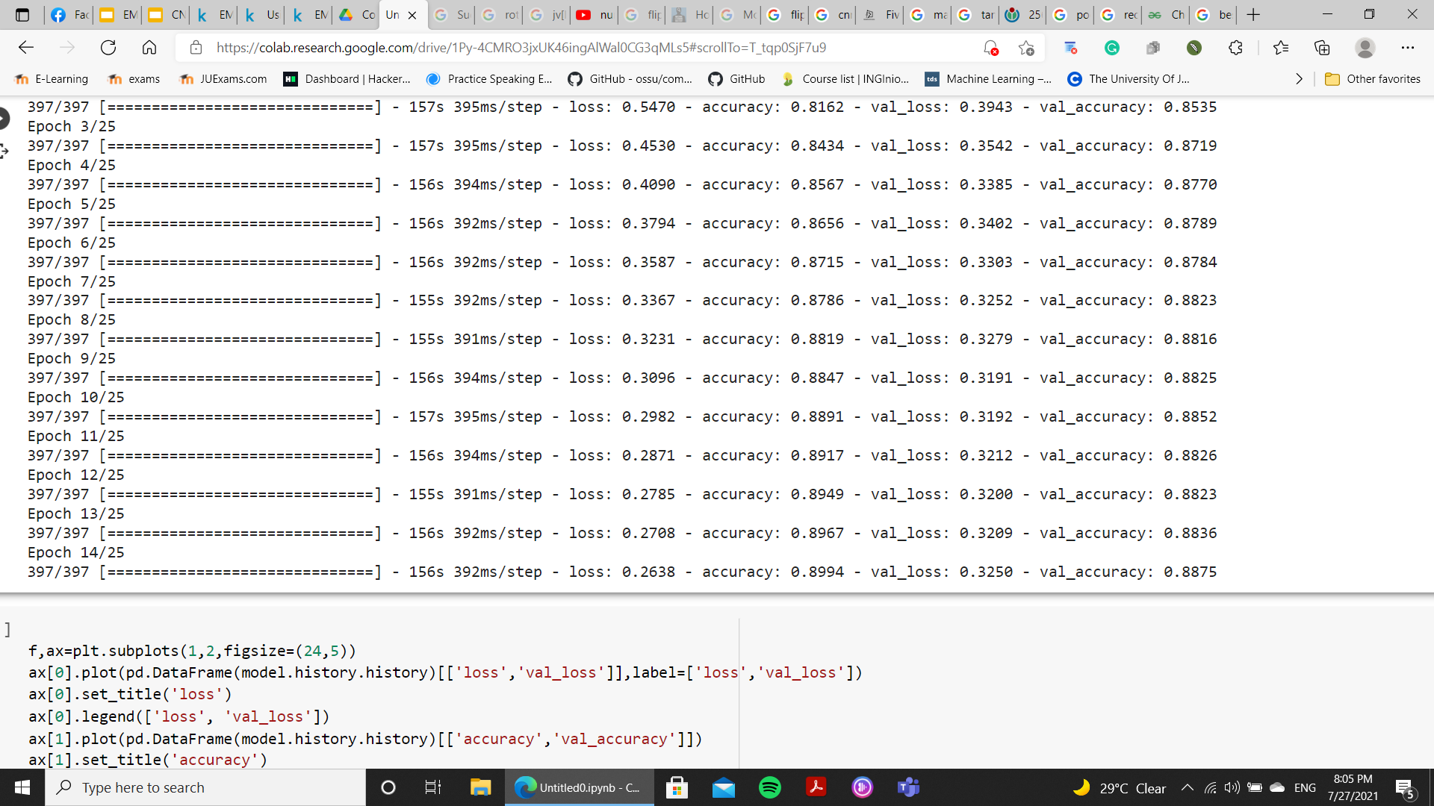
best model using early stopping
It stopped after 14 epoch
with 0.32 loss and 0.8875 accuracy on the validation data

Slide 30
04
Model Evaluation

Slide 31
loss and accuracy on test set
the model has 0.89 accuracy and 0.3184 loss on the test set
588/588 [==============================] - 10s 17ms/step - loss: 0.3184 - accuracy: 0.8890
[0.31836169958114624, 0.8890366554260254]

Slide 32
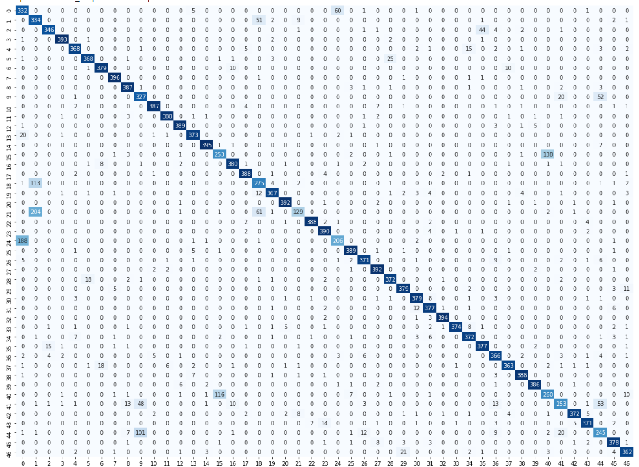
Confusion Matrix

Slide 33
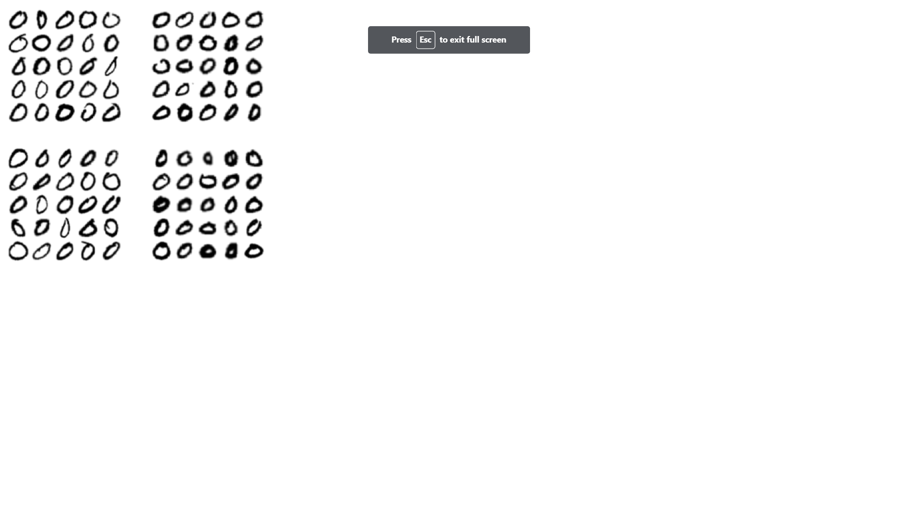
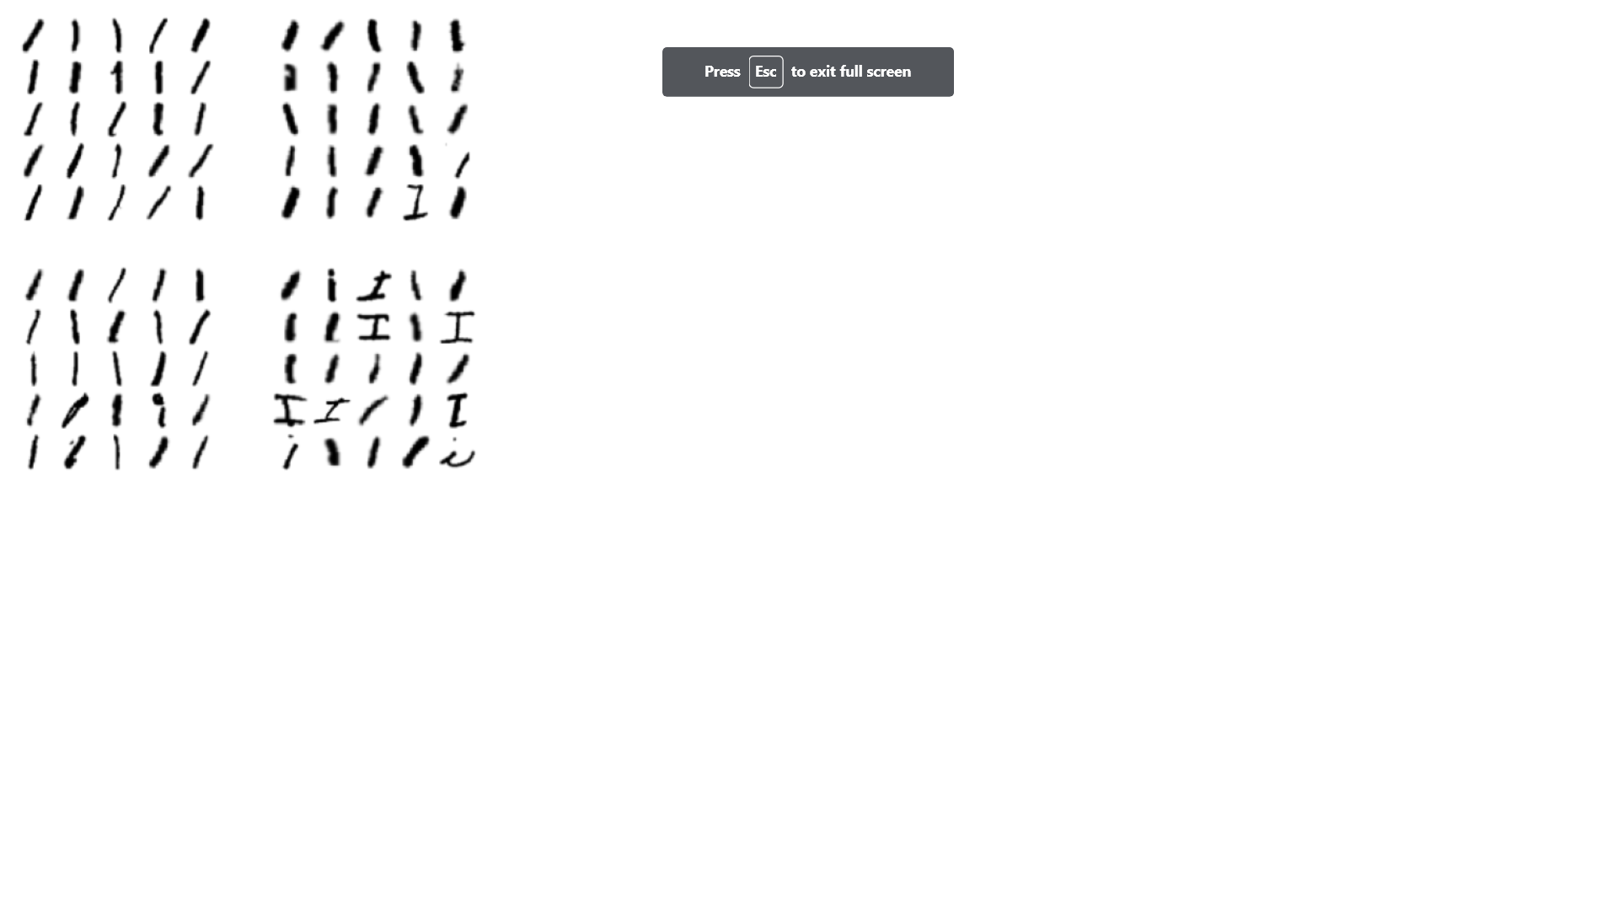
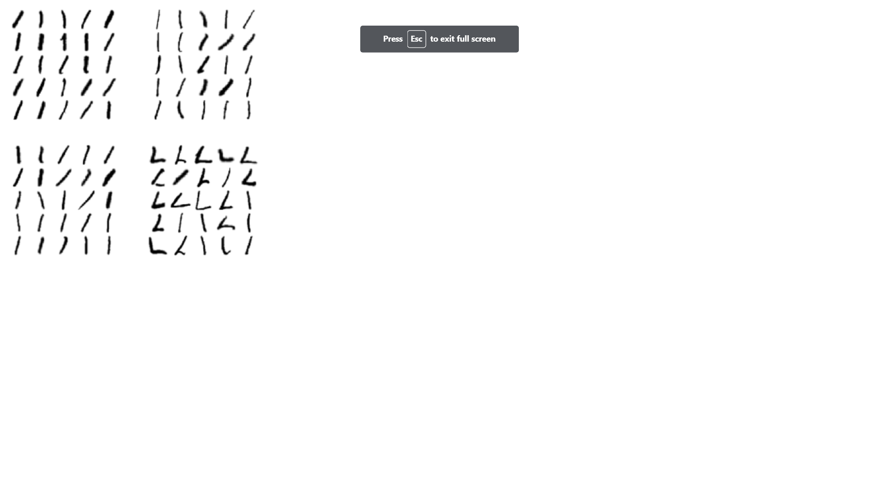
A High Rate Of Error

Slide 34
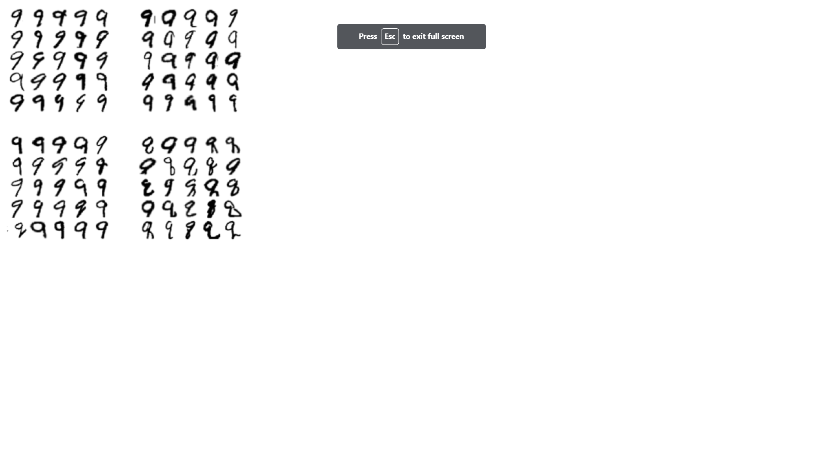

A High Rate Of Error

Slide 35
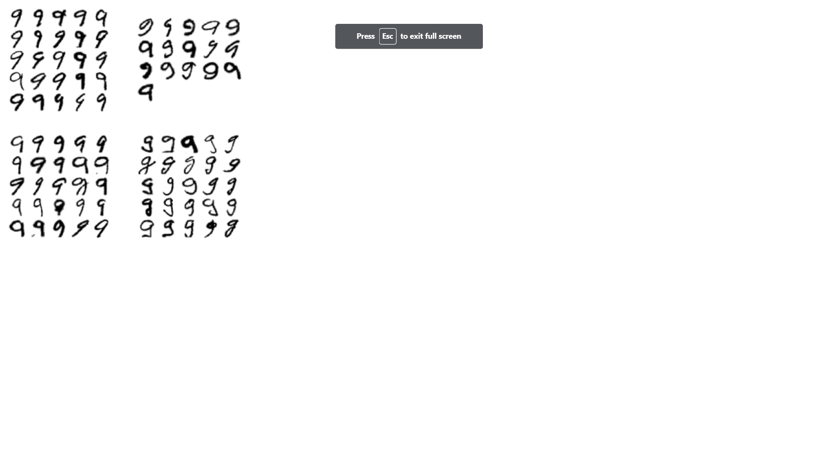
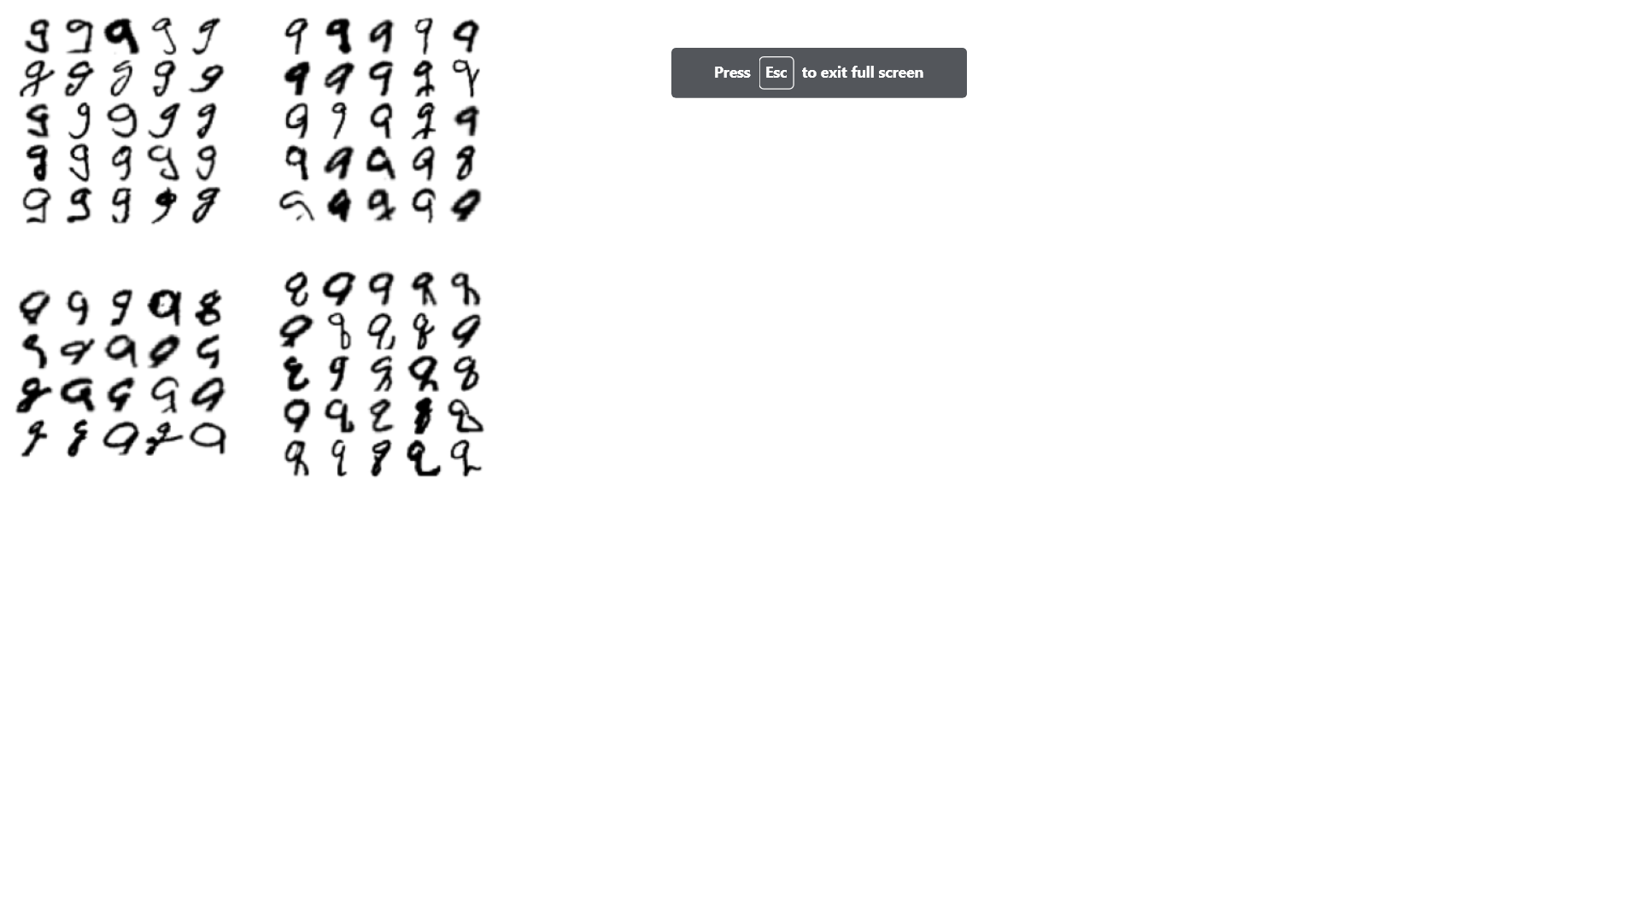
A Low Rate of Error

Slide 36
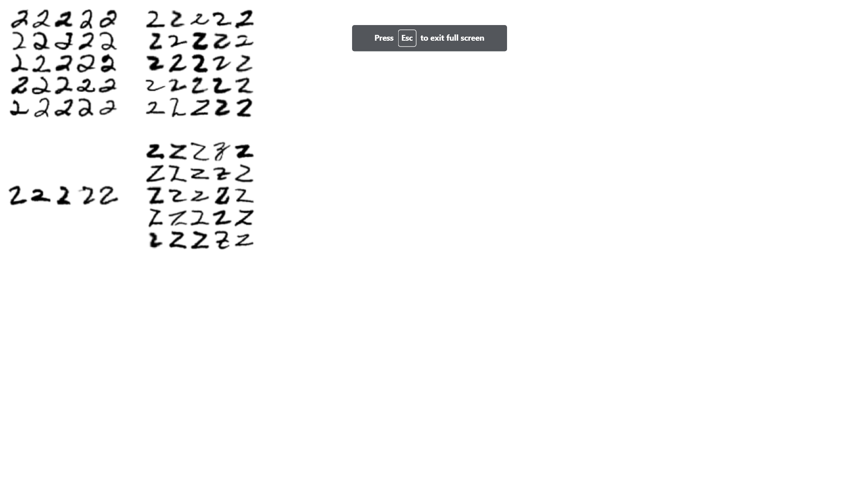
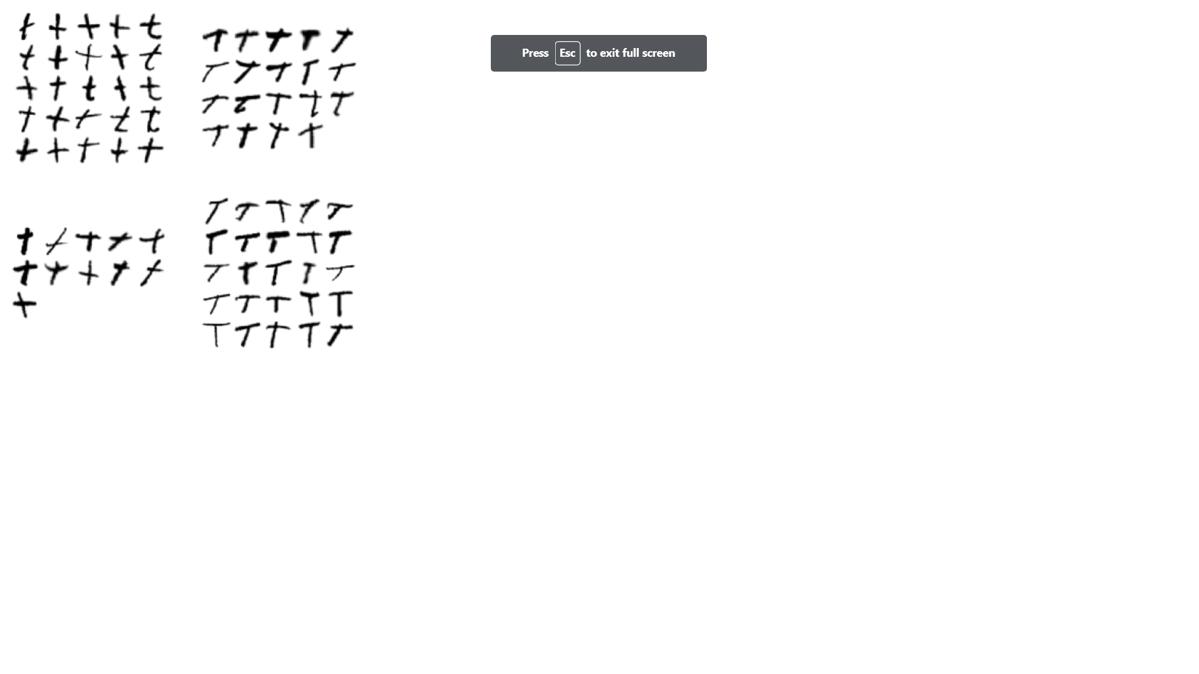
A Low Rate of Error

Slide 37
Thank You

